Slide 1
Nonlocal Nonlinear Schrödinger equation
Balázs Tari

Slide 2
Abstract
Nonlocality in space and time can be caused by various reasons.
To describe nonlocal properties of natural phenomena, integrals and derivatives of arbitrary and non-integer orders are usually used.
The properties of the nonlocal phenomena are also discussed.
To link to the current research, the goal of this paper is to implement the widely-used slip-step Fourier method (SSFM), including the fractional Euler method with which pulse propagation within optical fibers can be simulated.
Besides dispersion, nonlinear effects like the self-phase modulation (SPM) are considered.

Slide 3
Introduction
Nonlocality in space and time can be caused by various reasons, which can be connected with long-range interactions, fractional frequency and spatial dispersions, interaction with the environment, fading memory and distributed lag and scaling.
To describe nonlocal properties, integrals and derivatives of arbitrary and non-integer orders are usually used (see books [1], [2], [3], [4], [5], [6] and volumes of handbook [7], [8]).
Nonlocality in time should be taken into account, if fields change rapidly in time, in comparison with the characteristic relaxation time in the medium or in comparison with the periods of characteristic natural oscillations of the medium.

Slide 4
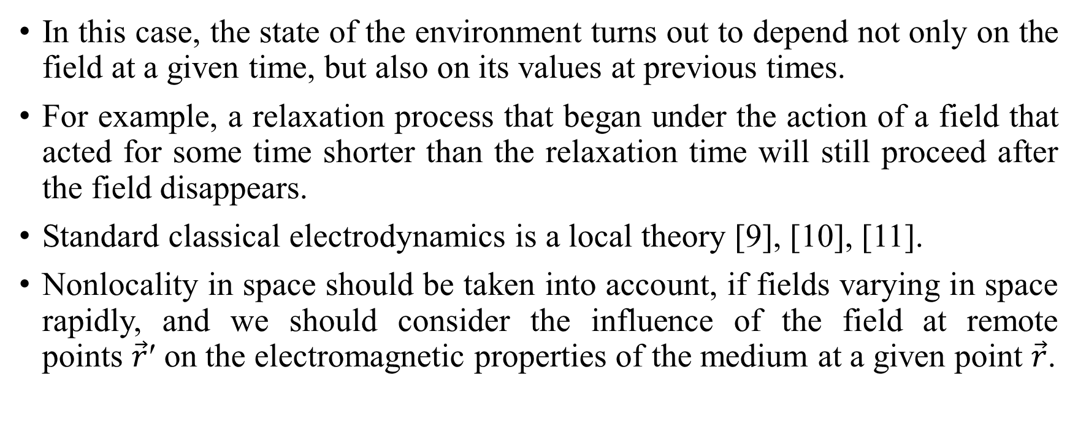
Introduction
In this case, the state of the environment turns out to depend not only on the field at a given time, but also on its values at previous times.
For example, a relaxation process that began under the action of a field that acted for some time shorter than the relaxation time will still proceed after the field disappears.
Standard classical electrodynamics is a local theory [9], [10], [11].
Nonlocality in space should be taken into account, if fields varying in space rapidly, and we should consider the influence of the field at remote points $\vec{r}$′ on the electromagnetic properties of the medium at a given point $\vec{r}$.

Slide 5
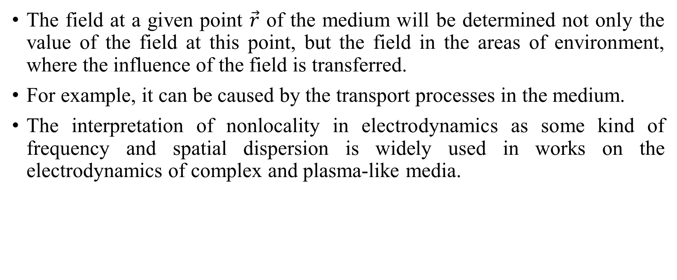
Introduction
The field at a given point $\vec{r}$ of the medium will be determined not only the value of the field at this point, but the field in the areas of environment, where the influence of the field is transferred.
For example, it can be caused by the transport processes in the medium.
The interpretation of nonlocality in electrodynamics as some kind of frequency and spatial dispersion is widely used in works on the electrodynamics of complex and plasma-like media.

Slide 6
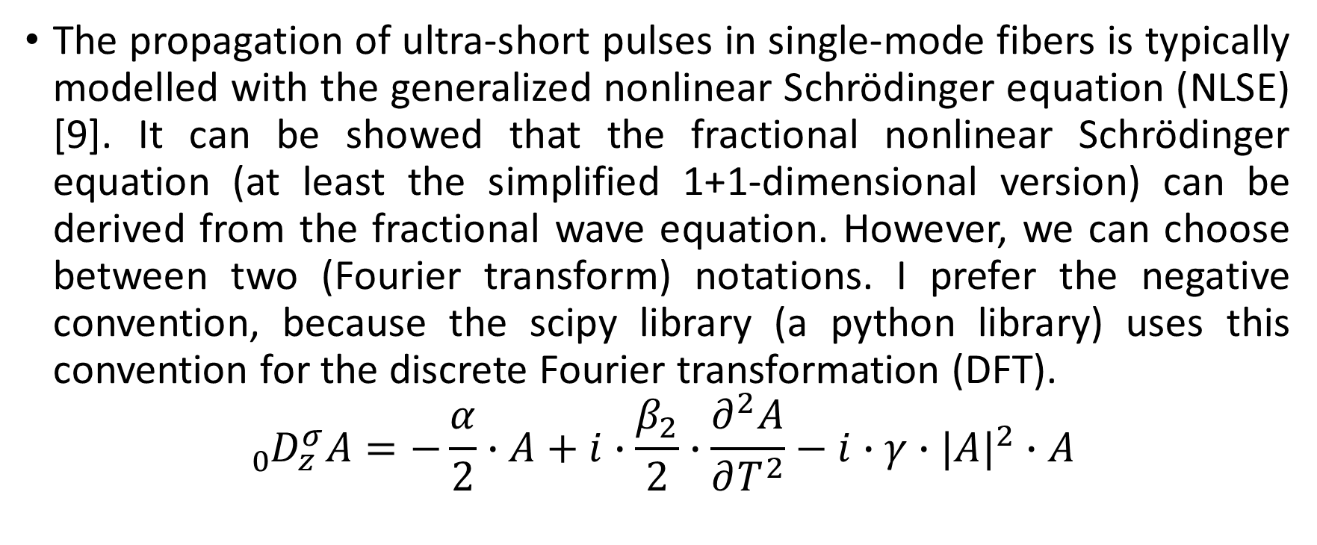
The fractional nonlinear Schrödinger equation
The propagation of ultra-short pulses in single-mode fibers is typically modelled with the generalized nonlinear Schrödinger equation (NLSE) [9]. It can be showed that the fractional nonlinear Schrödinger equation (at least the simplified 1+1-dimensional version) can be derived from the fractional wave equation. However, we can choose between two (Fourier transform) notations. I prefer the negative convention, because the scipy library (a python library) uses this convention for the discrete Fourier transformation (DFT).
$${{}_{0}^{}D}_{z}^{σ}A=−\frac{α}{2}∙A+i∙\frac{β_{2}}{2}∙\frac{∂^{2}A}{∂T^{2}}−i∙γ∙{|A|}^{2}∙A$$

Slide 7
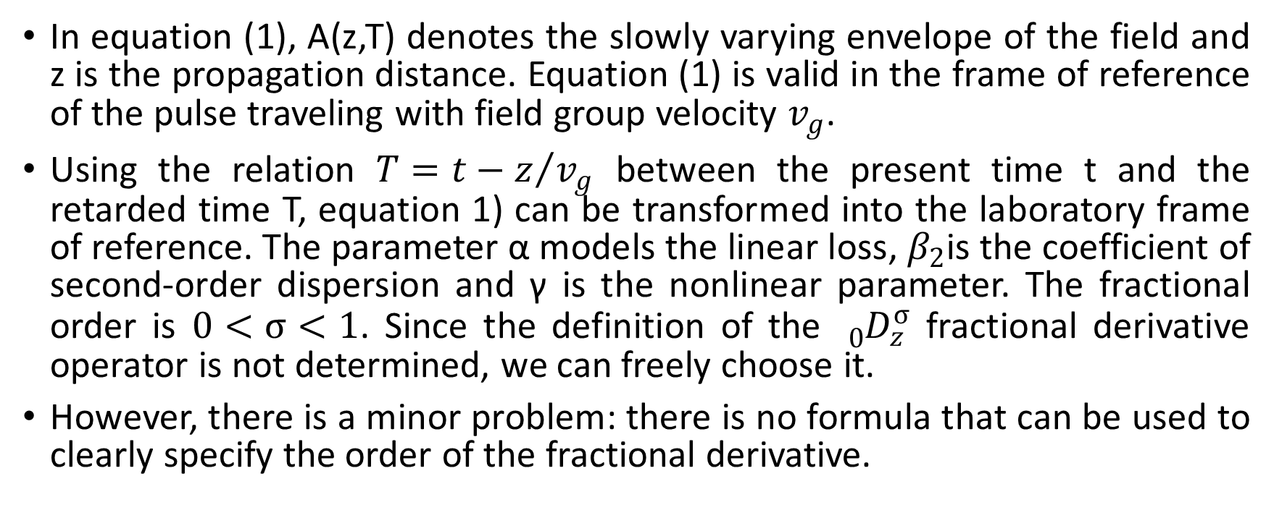
The fractional nonlinear Schrödinger equation
In equation (1), A(z,T) denotes the slowly varying envelope of the field and z is the propagation distance. Equation (1) is valid in the frame of reference of the pulse traveling with field group velocity $v_{g}$.
Using the relation $T=t−z/{v_{g}}$ between the present time t and the retarded time T, equation 1) can be transformed into the laboratory frame of reference. The parameter α models the linear loss, $β_{2}$is the coefficient of second-order dispersion and γ is the nonlinear parameter. The fractional order is $0<σ<1$. Since the definition of the ${{}_{0}^{}D}_{z}^{σ}$ fractional derivative operator is not determined, we can freely choose it.
However, there is a minor problem: there is no formula that can be used to clearly specify the order of the fractional derivative.

Slide 8
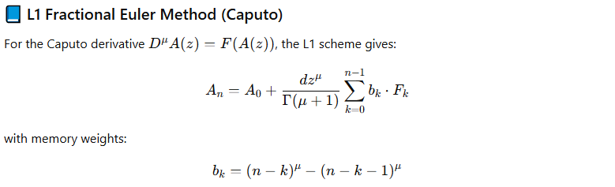
The fractional nonlinear Schrödinger equation

Slide 9
# Defining parameters for the simulation
# Initialize Gaussian pulse parameters (OCTAVIUS-85M-HP from THORLABS)
wavelength0=800*1e-9 # Pulse central wavelength [m]
frequency0=speed_of_light/wavelength0 # Pulse central frequency [Hz]
duration=8*1e-15 # Pulse duration in FWHM [s]
repetition_frequency=85*1e6 # Pulse repetition frequency [Hz]
average_power=600*1e-3 # Pulse average power [W]
pulse_energy=average_power/repetition_frequency # Pulse energy [J]
peak_power=pulse_energy/duration # Pulse peak power [W]
amplitude=np.sqrt(peak_power) # Electrical field strength amplitude [sqrt(W)]
#amplitude = np.sqrt((2 * pulse_energy) / (duration * np.sqrt(np.pi / np.log(2))))
N=2**10 # Number of points
Time_window=100e-15 # Time window [s]
theta=1.0 # Fractional order
chirp = 0 # Chirp parameter

Slide 10
# Defining the parameters of the fiber
Length=1e-4 # Fiber length [m]
nsteps=2**10 #2**10 # Number of steps we divide the fiber
effective_mode_diameter=5e-6 # Effective mode diameter [m]
effective_mode_area=(pi/4)*effective_mode_diameter**2 # Effective mode area [m^2]
peak_intensity = peak_power / effective_mode_area # Peak intensity [J/m^2]
nonlinear_refractive_index=2.7*1e-20 # Nonlinear refractive index [m^2/W]
gammaconstant=(2*pi*nonlinear_refractive_index)/(wavelength0*effective_mode_area) # Nonlinear parameter [1/(W*m)]
beta2=36.16 # GVD in fs^2/mm
beta2*=(1e-30) # Convert GVD to s^2/m
alpha_dB_per_m=0.2*1e-3 # Power attenuation coeff [dB/m]
# Some useful parameters
nonlinear_length=1/(gammaconstant*peak_power) # Nonlinear length [m]
dispersion_length=(duration**2)/(np.abs(beta2)) # Dispersion length [m]

Slide 11
class SIM_config2:
def __init__(self,N,time_window,duration,wavelength0,alpha,chirp):
self.chirp = chirp
self.alpha = alpha
self.number_of_points=N
self.wavelength0 = wavelength0
self.duration = duration
self.t = np.linspace(-time_window/2,time_window/2,N)
self.dt = abs(self.t[1] - self.t[0])
self.f = fftshift(fftfreq(N,d=self.dt))
self.omega = self.f * 2 *pi
class Fiber_config2:
def __init__(self,nsteps,length,nonlinear_length,dispersion_length,alpha_dB_per_m,beta2,gammaconstant):
self.nsteps=nsteps
self.length = length
self.dz = length / nsteps
self.zlocs_array=np.linspace(0,length,nsteps)
self.nonlinear_length = nonlinear_length
self.dispersion_length = dispersion_length
self.alpha_dB_per_m = alpha_dB_per_m
self.beta2 = beta2
self.gammaconstant = gammaconstant

Slide 12
# Function returns pulse power or spectrum PSD
def getPower(amplitude):
return np.abs(amplitude) ** 2
def getPhotonNumber(A, sim:SIM_config2):
"""
Calculate photon number using:
N = ∭ |A(t)|^2 / (ħω) dt
"""
I = getPower(A)
photon_energy = hbar * (sim.omega +2*pi*speed_of_light/wavelength0)
I_over_hw = I / photon_energy
photon_number = np.trapz(I_over_hw, sim.t)
return photon_number

Slide 13
def estimate_stable_dz(gamma, P0, lambda0, n0, beta2=None, omega_max=None, C_nl=0.1, C_phi=0.1):
"""
Estimate physically stable step size Δz for SSFM in NLSE.
Parameters:
gamma : Nonlinear coefficient [1/(W·m)]
P0 : Peak power [W]
lambda0 : Central wavelength [m]
n0 : Linear refractive index
beta2 : (Optional) GVD coefficient [s^2/m]
omega_max : (Optional) max angular frequency content [rad/s]
C_nl : Safety factor for nonlinear phase shift
C_phi : Safety factor for spatial phase shift
Returns:
dz_suggested : Estimated stable step size [m]
"""
dz_nl = C_nl / (gamma * P0)
dz_phi = C_phi * lambda0 / (2 * np.pi * n0)
if beta2 is not None and omega_max is not None:
dz_disp = 1 / (np.abs(beta2) * omega_max**2)
return min(dz_nl, dz_phi, dz_disp)
return min(dz_nl, dz_phi)

Slide 14
def estimate_grid_resolution(tau0, omega_max=None):
"""
Estimate temporal and spatial grid resolutions.
Parameters:
tau0 : Pulse duration (e.g., FWHM) [s]
omega_max : Maximum angular frequency content (optional) [rad/s]
Returns:
dt_est : Temporal grid spacing [s]
"""
# Temporal resolution based on pulse duration
dt_est = tau0 / 10
# If max spectral content is known, enforce Nyquist
if omega_max is not None:
dt_nyquist = np.pi / omega_max
dt_est = min(dt_est, dt_nyquist)
return dt_est

Slide 15
def GaussianPulseTime(time,amplitude,duration):
return amplitude*np.exp(-2*np.log(2)*((time)/(duration))**2)*(1+0j)
def chirpedGaussianPulseTime(time,amplitude,duration,chirp):
return amplitude*np.exp(-((1+1j*chirp)/2)*(time/duration)**2)
def getSpectrumFromPulse(time,pulse_amplitude):
dt=time[1]-time[0]
spectrum_amplitude=fftshift(fft(pulse_amplitude))*dt
return spectrum_amplitude
def getPulseFromSpectrum(time,spectrum_aplitude):
dt=time[1]-time[0]
pulse=ifft(ifftshift(spectrum_aplitude))/dt
return pulse

Slide 16
def analyze_pulse_characteristics(x, I, rat):
"""
Calculates the FWHM or other width-like characteristics of a pulse.
Parameters:
- x (np.array): time or frequency array
- I (np.array): intensity array
- rat (float): threshold ratio (e.g., 0.5 for FWHM, 0.05 for 5% bandwidth)
- Mult (float): optional multiplier to convert units (default: 1)
Prints the pulse width in appropriate units.
"""
max_I = np.max(I)
I_thresh = max_I * rat
# Find indices where intensity is above the threshold
indices = np.where(I >= I_thresh)[0]
if indices.size == 0:
width_x = 0
else:
# Guard against out-of-bounds
if indices[0] == 0 or indices[-1] == len(x) - 1:
print("Warning: Threshold too close to boundary. Skipping interpolation.")
xa1 = x[indices[0]]
xa2 = x[indices[-1]]
else:
# Linear interpolation around threshold crossings
x1, x2 = x[indices[0] - 1], x[indices[0]]
f1, f2 = I[indices[0] - 1], I[indices[0]]
xa1 = ((I_thresh - f1) * x2 + (f2 - I_thresh) * x1) / (f2 - f1)
x3, x4 = x[indices[-1]], x[indices[-1] + 1]
f3, f4 = I[indices[-1]], I[indices[-1] + 1]
xa2 = ((I_thresh - f4) * x3 + (f3 - I_thresh) * x4) / (f3 - f4)
width_x = xa2 - xa1
return width_x

Slide 17
def to_interaction_picture(A,sim,fiber):
Lw = 1j * (beta2 / 2) * sim.omega**2
exp_halfL = np.exp(Lw * fiber.dz / 2)
return fftshift(ifft(ifftshift(fftshift(fft(ifftshift(A))) * exp_halfL)))
def from_interaction_picture(psi,sim,fiber):
Lw = 1j * (fiber.beta2 / 2) * sim.omega**2
exp_halfL = np.exp(Lw * fiber.dz / 2)
return fftshift(ifft(ifftshift(fftshift(fft(ifftshift(psi))) * exp_halfL)))
def RHS_IP(psi,sim,fiber):
A_phys = from_interaction_picture(psi,sim,fiber)
nonlinear_term = -1j * fiber.gammaconstant * np.abs(A_phys)**2 * A_phys
loss_term = - (fiber.alpha_dB_per_m / 2) * A_phys
return to_interaction_picture(nonlinear_term + loss_term,sim,fiber)

Slide 18
def compute_L1_weights(mu, N):
weights = np.zeros(N)
for k in range(N):
weights[k] = (k + 1)**mu - k**mu
return weights

Slide 19
def compute_L1_weights(mu, N):
weights = np.zeros(N)
for k in range(N):
weights[k] = (k + 1)**mu - k**mu
return weights
def FL1IP(fiber:Fiber_config,sim:SIM_config,pulse):
A_history = [pulse]
A0_spectrum = getSpectrumFromPulse(sim.t,pulse)
A_spectrum_history = [A0_spectrum]
psi_0 = to_interaction_picture(pulse,sim,fiber)
F_list = [RHS_IP(psi_0,sim,fiber)]
psi_list = [psi_0]
A0_PhotonNumber = getPhotonNumber(pulse,sim)
PhotonNumber_values = [A0_PhotonNumber]
weights = compute_L1_weights(sim.alpha, fiber.nsteps)
prefactor = fiber.dz**sim.alpha / gamma(sim.alpha + 1)
for n in range(fiber.nsteps-1):
mem_sum = np.zeros_like(pulse, dtype=np.complex128)
for k in range(n):
mem_sum += weights[n - 1 - k] * F_list[k]
psi_next = psi_list[0] + prefactor * mem_sum
psi_list.append(psi_next)
F_next = RHS_IP(psi_next,sim,fiber)
A_next = from_interaction_picture(psi_next,sim,fiber)
PhotonNumber_values.append(getPhotonNumber(A_next,sim))
F_list.append(F_next)
A_history.append(A_next)
A_spectrum_next = getSpectrumFromPulse(sim.t,A_next)
A_spectrum_history.append(A_spectrum_next)
delta = int(round(n*100/fiber.nsteps)) - int(round((n-1)*100/fiber.nsteps))
if delta == 1:
print(str(int(round(n*100/fiber.nsteps))) + " % ready")
return A_history, A_spectrum_history, PhotonNumber_values

Slide 20
Stable dt value: 9.794300558772306e-17 Stable dz value: 1.273239544735163e-08 Crytical power condition is not satisfied for self-focusing! Clean pulse propagation or compression is achieved! Kerr + SPM regime!

Slide 21
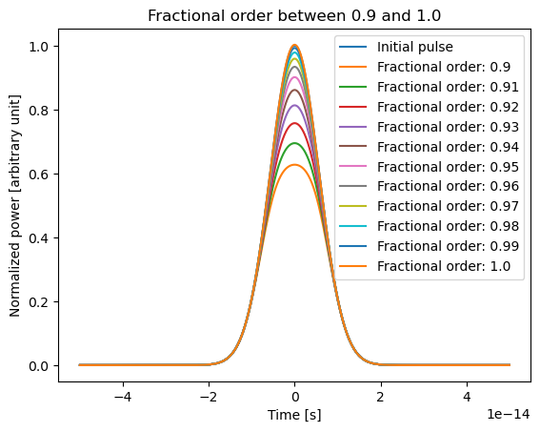

Slide 22
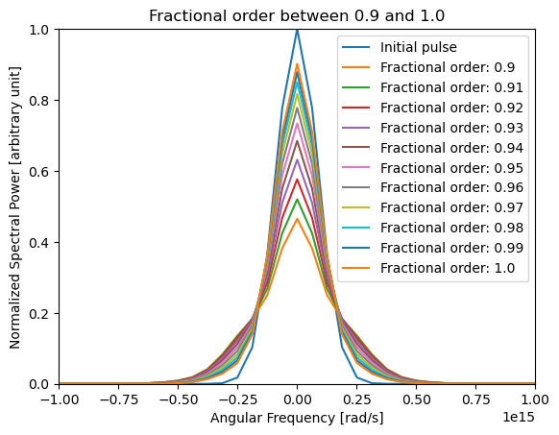

Slide 23
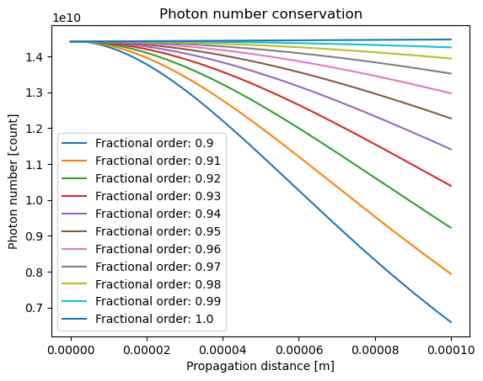

Slide 24
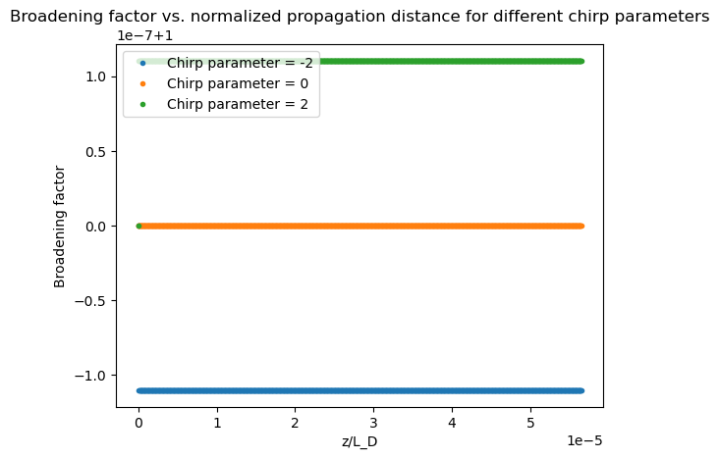

Slide 25
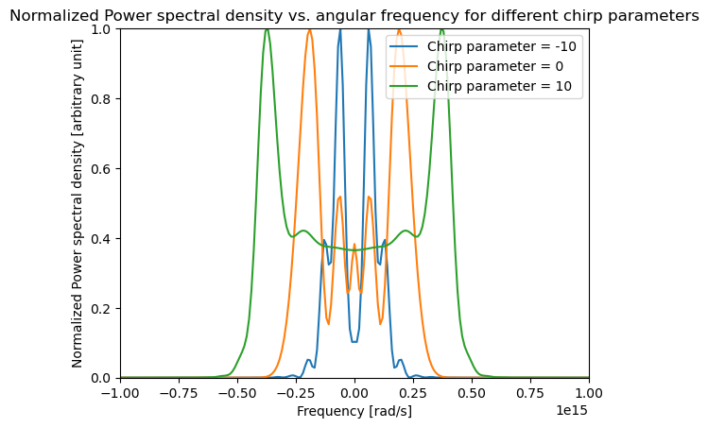

Slide 26
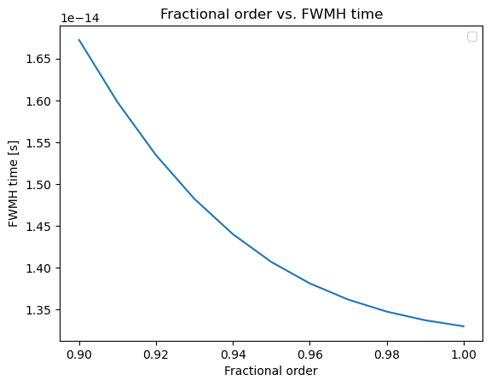
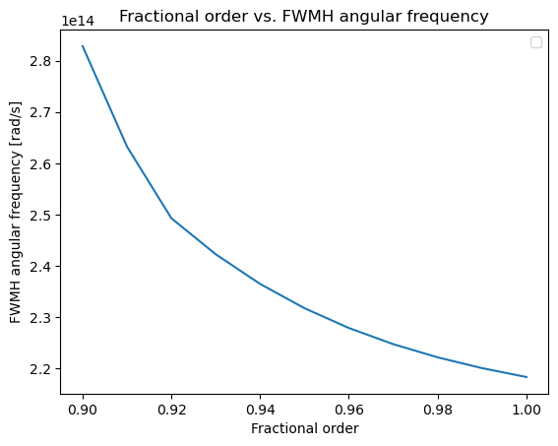
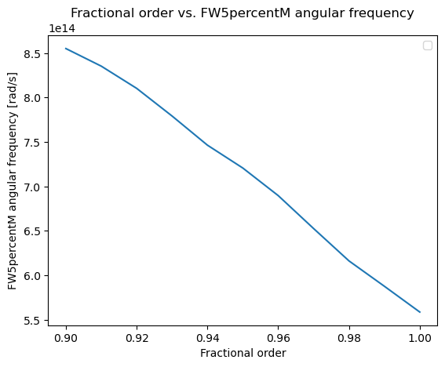
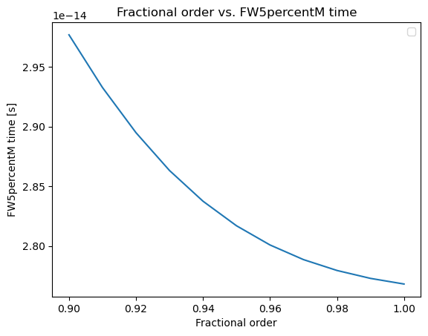

Slide 27
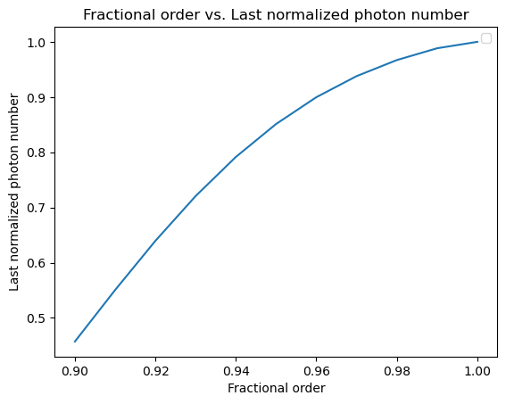

Slide 28
Thank you for your attention!

Slide 29
References
[1] S.G. Samko, A.A. Kilbas, O.I. Marichev, Integrals and Derivatives of Fractional Order and Applications, Nauka iTehnika, Minsk, 1987.
[2] S.G. Samko, A.A. Kilbas, O.I. Marichev, Fractional Integrals and Derivatives Theory and Applications, Gordon and Breach, New York, 1993.
[3] V. Kiryakova, Generalized Fractional Calculus and Applications, Longman and J. Wiley, New York, ISBN: 9780582219779, 1994, p. 360.
[4] I. Podlubny, Fractional Differential Equations, Academic Press, San Diego, ISBN: 978-0-12-558840-9, 1998.
[5] A.A. Kilbas, H.M. Srivastava, J.J. Trujillo, Theory and Applications of Fractional Differential Equations, Elsevier, Amsterdam, ISBN: 9780444518323, 2006.
[6] F. Diethelm, The Analysis of Fractional Differential Equations. An Application-Oriented Exposition using Differential Operators of Caputo Type, Springer-Verlag, Berlin, Heidelberg, 2010, http://dx.doi.org/10.1007/978-3-642-14574-2.
[7] A. Kochubei, Yu Luchko, Handbook of Fractional Calculus with Applications, in: Basic Theory, vol. 1, Walter de Gruyter GmbH, Berlin, Boston, 2019, p. 481, http://dx.doi.org/10.1515/9783110571622.
[8] A. Kochubei, Yu Luchko, Handbook of Fractional Calculus with Applications, in: Fractional Differential Equations, vol. 2, Walter de Gruyter GmbH, Berlin, Boston, 2019, p. 519, http://dx.doi.org/10.1515/9783110571660.
[9] J.D. Jackson, Classical Electrodynamics, third ed., John Wiley and Sons, New York, 1998, p. 832.
[10] A.A. Vlasov, Macroscopic Electrodynamics, second ed., GITTL, Moscow, ISBN: 5-9221-0560-4, 1955, p. 228, FIZMATLIT, Moscow, 2005. p. 240.
[11] D.J. Griffiths, Introduction to Electrodynamics, third ed., Prentice Hall, New Jersey, ISBN: 9780138053260, 1999, p. 580, 0-13-805326-X.

